Slide 1
Rationale Management
Lauren DiCristofaro
Abdulkarim Egal
Vishal Patel

Slide 2
Goals for the sprint
Define how to harden database (not just rationale)
Add Collapsing and Expanding Rationale info
Add ability to Edit & Delete Rationale info
Update some existing class diagrams
Remove previous code referencing Comments

Slide 3
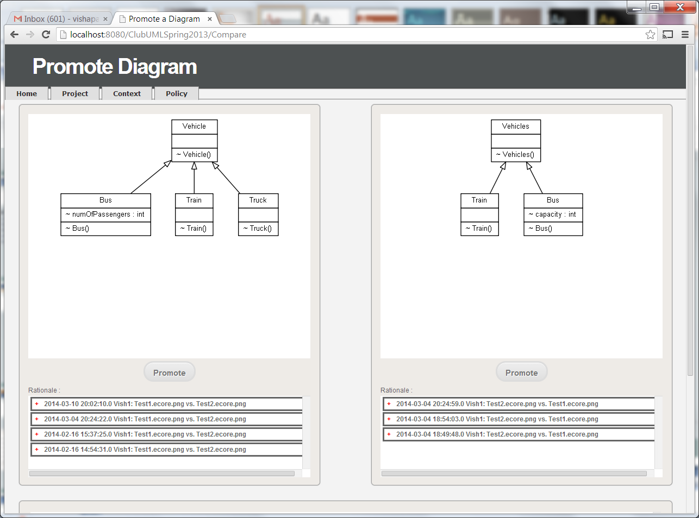

Slide 4
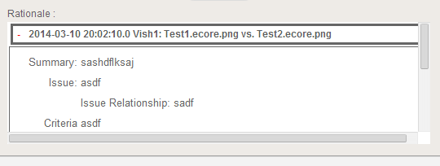

Slide 5
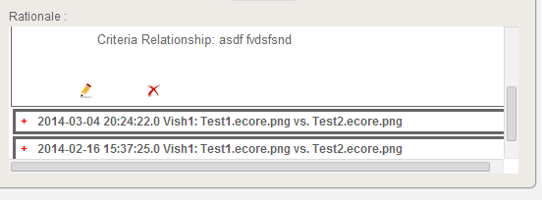

Slide 6
Changes Made
promote.jsp
changes for expand/collapse
changes for edit/delete
promote_style.css
Style sheet for expand/collapse box
CompareDAO.java
changes to add decrement count for un-promoting

Slide 7
Changes Made
Promote.java
Handle the new edit or delete
RationaleDAO.java
Added changes for editing and deleting the DB

